Slide 1

Development of machine learning models to process Electronic Health Records – Explainable Models
Week 3 Meeting, 17/10/2021

Slide 2
WhAT I have done
Watched most of videos from across all weeks from module 1 and some in module 2
Studied the notebooks and recourses on the moduleDatabase file
Getting used to postgres (took a lot of time)
Successfully build the data on linux VM

Slide 3


Cant create database
Normal doing CREATE DATABASE mimic; should create a database but in my case it was stuck
Found the cause of the problem: I am using linux subsystem on windows
https://github.com/microsoft/WSL/issues/61

Slide 4
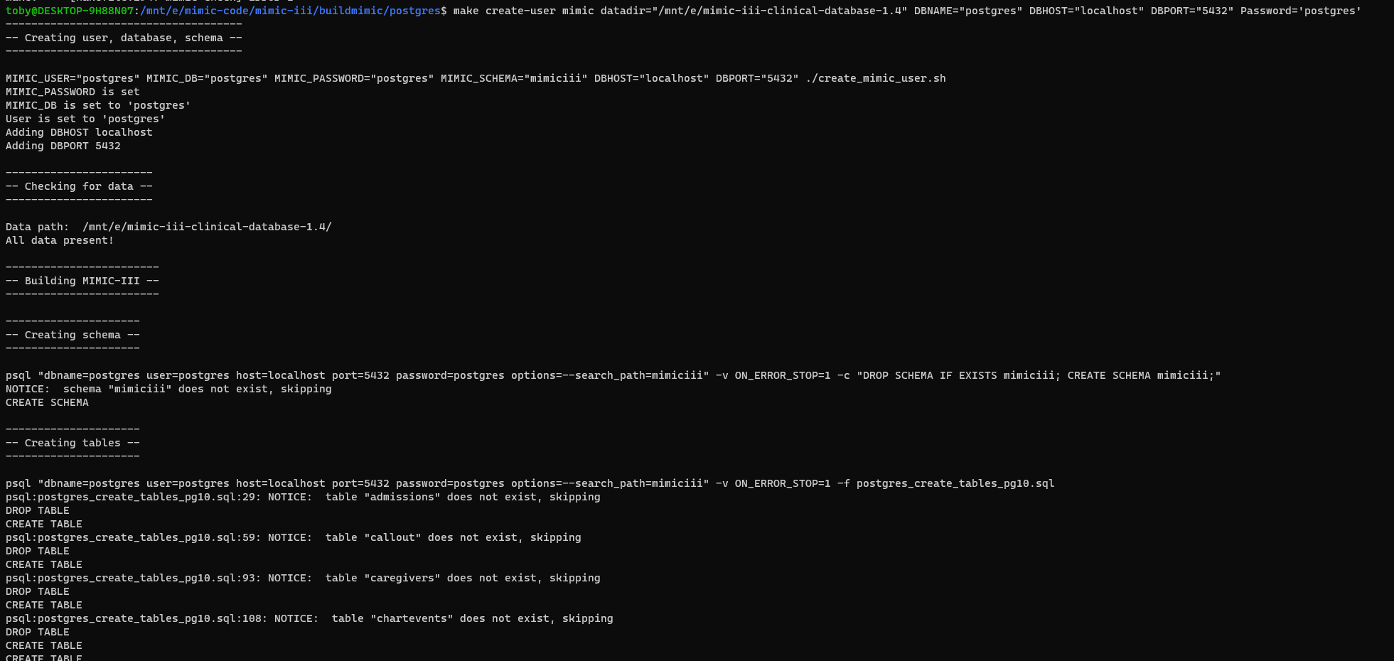
Have to use postgres as database
Ideally, I would create a new database called mimic
Since I couldn’t create a mimic database I tried using the existing database postgres

Slide 5
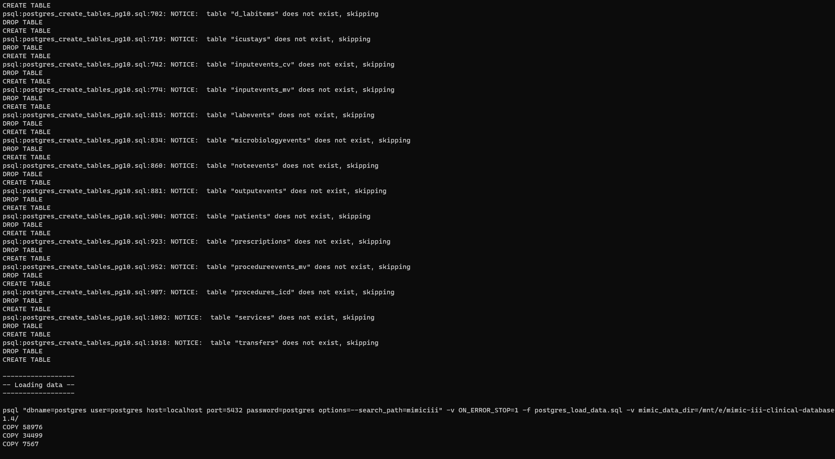
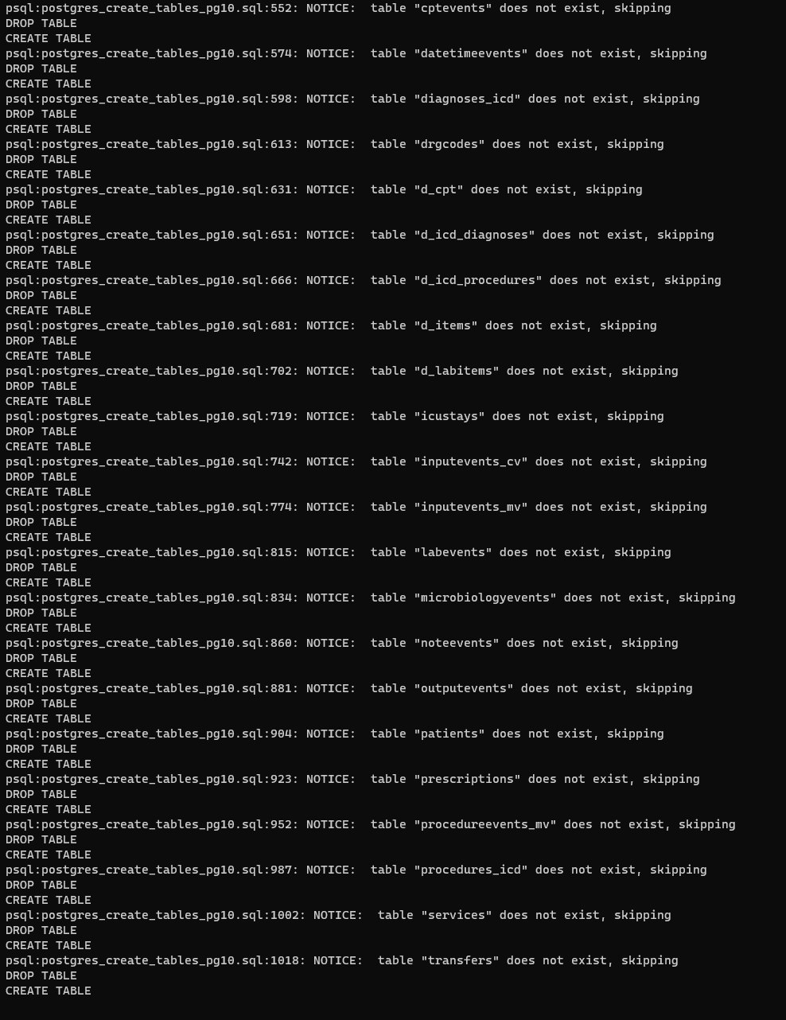
Couldn’t find the tables, stuck on copy
make create-user mimic datadir="/mnt/e/mimic-iii-clinical-database-1.4" DBNAME=“mimic" DBHOST="localhost" DBPORT="5432" Password='postgres'

Slide 6
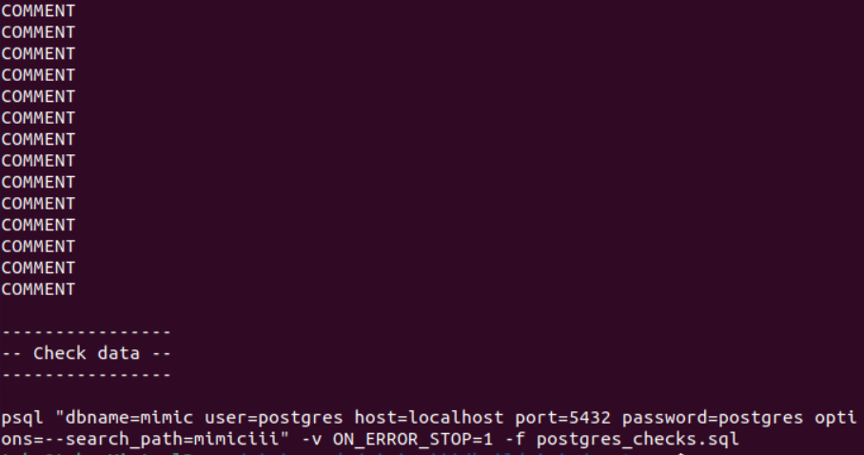
Just Successfully built the database on linux vm
Must download the notebook and python on the VM
Will working in VM affect the machine learning efficiency?

